Slide 1

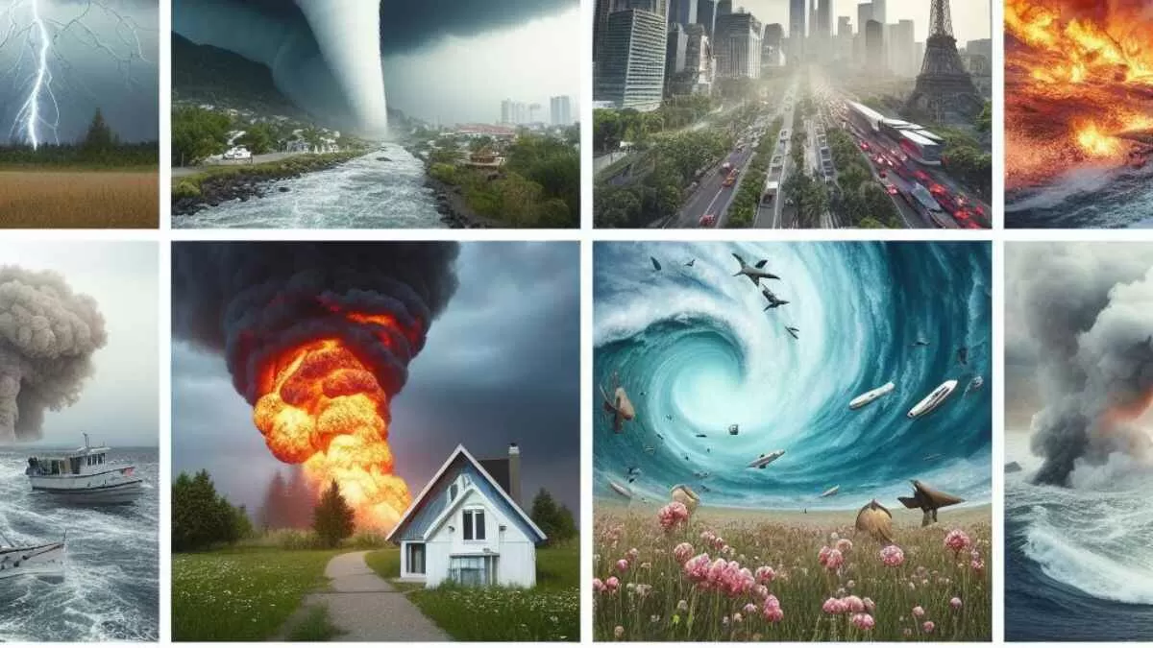
ALL DISASTERS 1970-2021
Group 8 members:
Anupreet Kaur
Sara Joulaei
Zara Pazouki
Zena Lawrence

Slide 2

Introduction
This project aims to provide valuable insights into the impacts of natural disasters and inform strategies to better prepare for and mitigate future events.
Data would be analyzed to check:
Trend Analysis
Geographic Distribution
Seasonal Pattern
Human Impact
Economic Impact
Notes:
Natural disasters have had profound impacts on human societies, economies, and the environment throughout history. The “ALL NATURAL DISASTERS 1970-2021 / EOSDIS” dataset provides a comprehensive overview of these events, encompassing a wide range of disasters, including earthquakes, floods, hurricanes, and wildfires. This project aims to explore the historical data on natural disasters to uncover trends, patterns, and correlations that can inform preparedness and mitigation strategies.

Slide 3
DISASTERS 1970-2021
Year | Disaster Group | Disaster Subgroup | Disaster Type | Country | Region | Continent | Start Year | Start Month | End Year | End Month | Total Deaths | Total Affected | Total Damages ('000 US$)
1970 | Natural | Hydrological | Flood | Argentina | South America | Americas | 1970 | 1.0 | 1970 | 1.0 | 36.0 | - | 25000.0
1970 | Natural | Meteorological | Storm | Australia | Australia and New Zealand | Oceania | 1970 | 1.0 | 1970 | 1.0 | 13.0 | - | 72475.0
1970 | Natural | Hydrological | Flood | Benin | Western Africa | Africa | 1970 | 9.0 | 1970 | 9.0 | - | - | 200.0
1970 | Natural | Meteorological | Storm | Bangladesh | Southern Asia | Asia | 1970 | 11.0 | 1970 | 11.0 | 300000.0 | 3648000.0 | 86400.0
1970 | Natural | Meteorological | Storm | Bangladesh | Southern Asia | Asia | 1970 | 4.0 | 1970 | 4.0 | 17.0 | 110.0 | -
Reference: https://www.kaggle.com/datasets/brsdincer/all-natural-disasters-19002021-eosdis https://utorvirtdatap-8p31345.slack.com/archives/C07EX4ECLQM/p1722476607457499

Slide 4
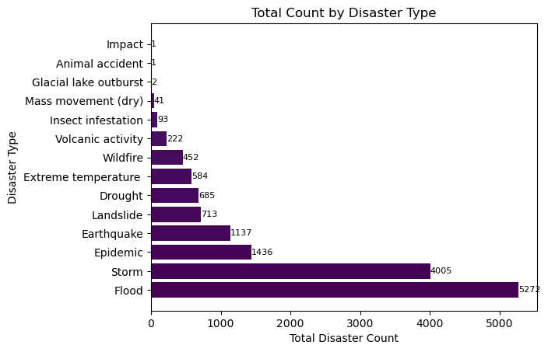
Trend Analysis:
How have the frequency of different types of natural disasters changed from 1970 to 2021?
Total Disaster Types 1970 - 2021
Disaster Type | Disaster Counts | Total
Flood | 5 | 5272
Storm | 11 | 4005
Epidemic | 3 | 1436
Earthquake | 2 | 1137
Landslide | 9 | 713
Drought | 1 | 685
Extreme temperature | 4 | 584
Wildfire | 13 | 452
Volcanic activity | 12 | 222
Insect infestation | 8 | 93
Mass movement (dry) | 10 | 41
Glacial lake outburst | 6 | 2
Animal accident | 0 | 1
Impact | 7 | 1
Notes:
Flood is most frequent disaster

Slide 5
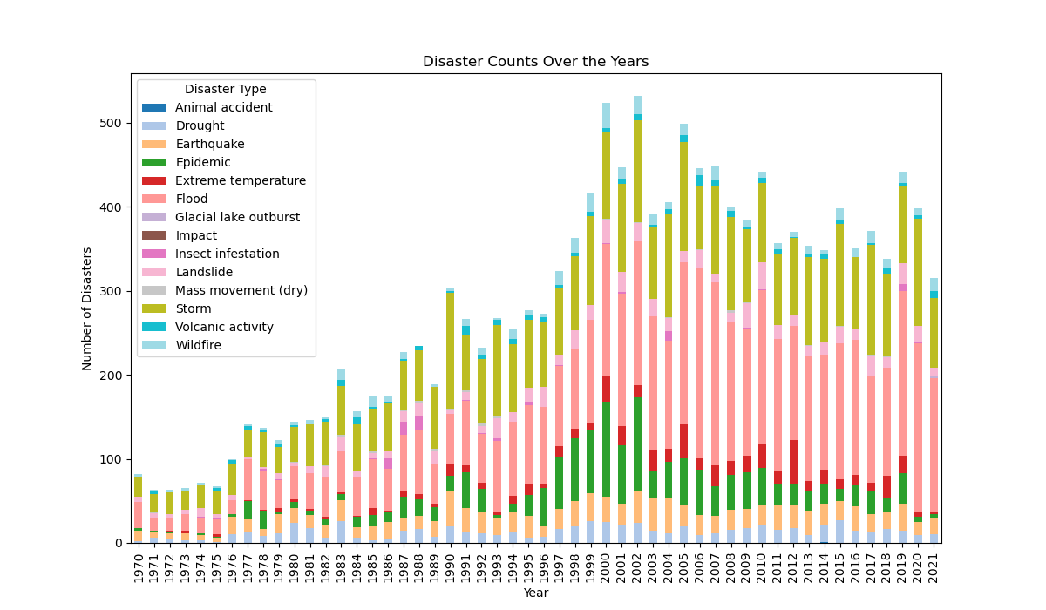
How have the occurrences of earthquakes, floods, hurricanes, wildfires, and other natural disasters varied over time?
]
Notes:
Are there specific decades or years with significantly higher numbers of disasters?In 2002, the highest number of disasters occurred.

Slide 6
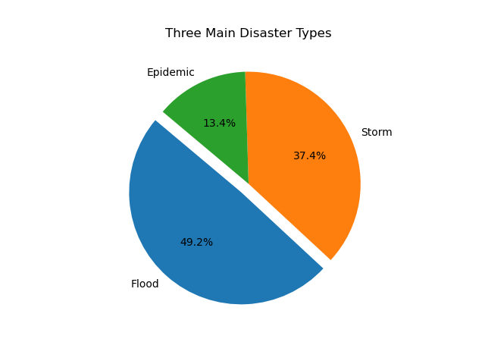

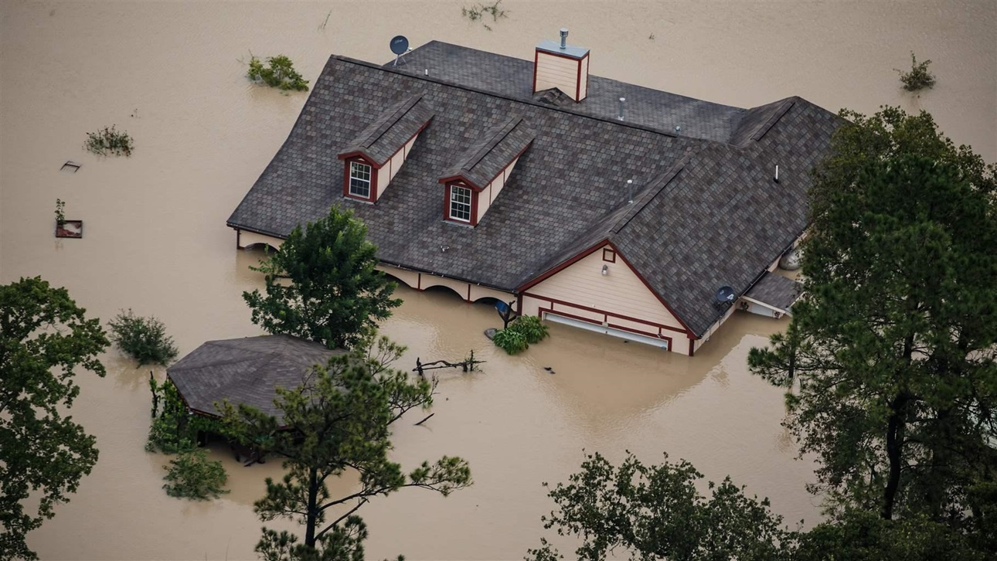
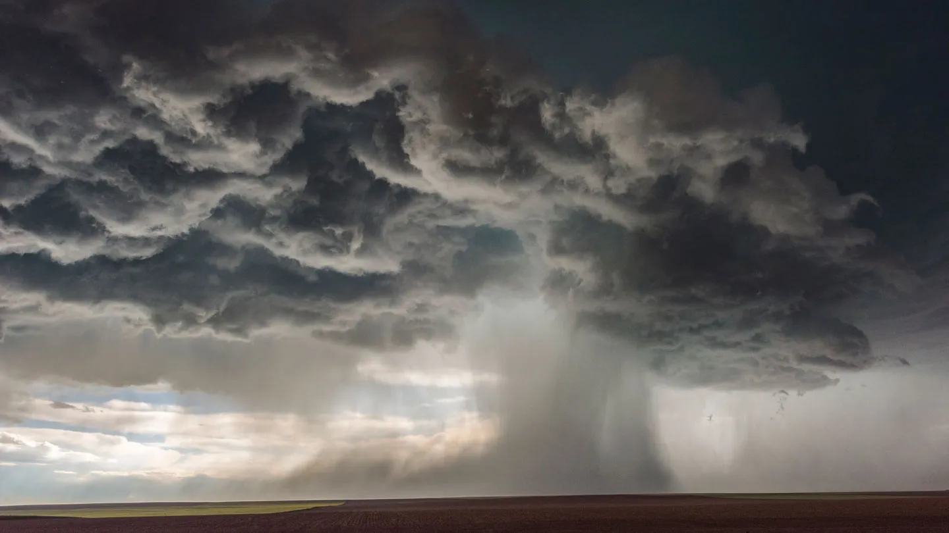
What are the three most frequent disasters over these years?

Slide 7
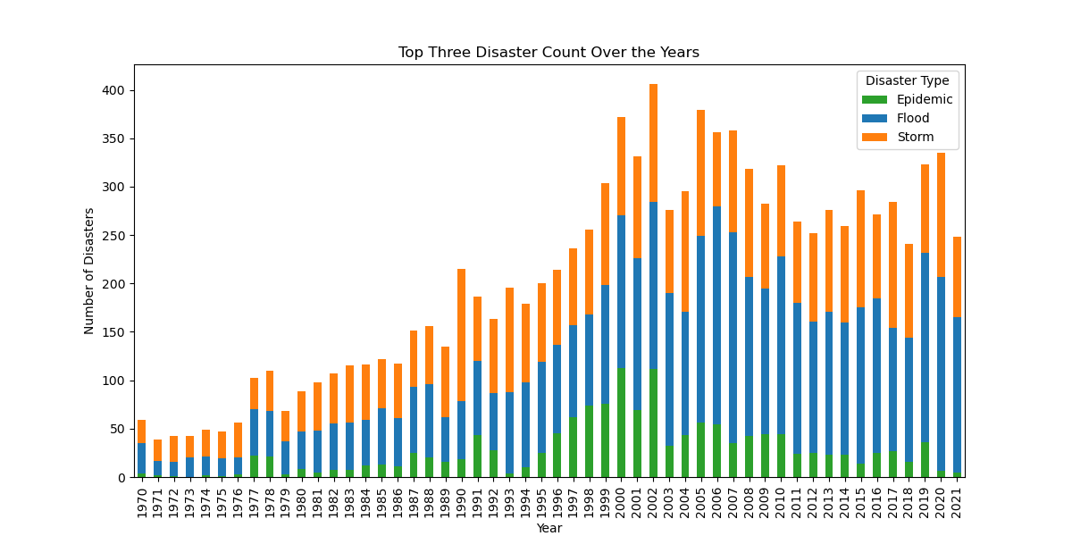
What is the frequency of the three main disasters over these years?

Slide 8
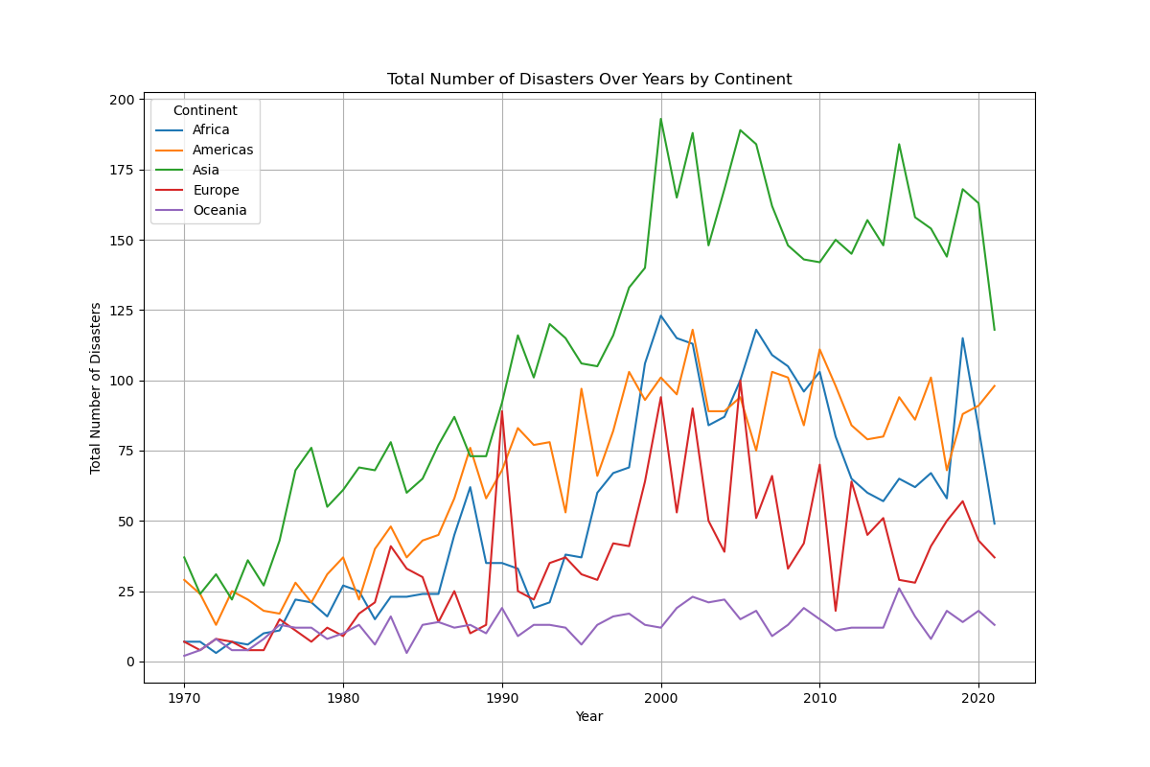
Geographic Distribution:
 | Total Deaths | Total Deaths | Total Affected | Total Affected | Total Damages ('000 US$) | Total Damages ('000 US$)
 | mean | median | mean | median | mean | median
Africa | 478.9 | 20.0 | 249568.7 | 5141.0 | 125483.9 | 13561.0
Americas | 232.8 | 11.0 | 173262.8 | 4417.5 | 1152306.3 | 115000.0
Asia | 439.3 | 24.0 | 1490445.6 | 13909.0 | 759251.5 | 53100.0
Europe | 186.9 | 6.0 | 43509.1 | 1000.0 | 563641.0 | 110000.0
Oceania | 24.4 | 5.0 | 56829.7 | 2000.0 | 319810.1 | 39427.0
What patterns emerge when analysing the frequency of disasters by continent?

Slide 9
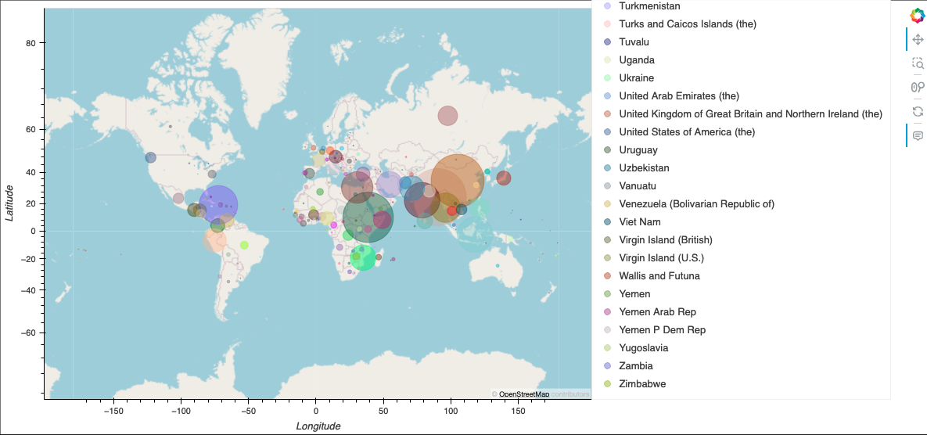
Map
Which regions and countries have been most affected by natural disasters?

Slide 10
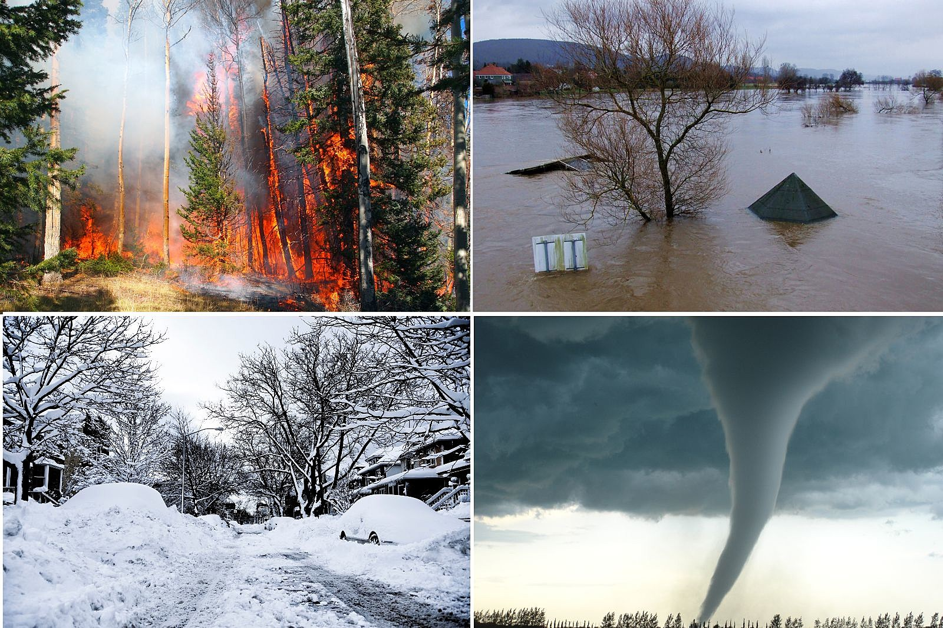
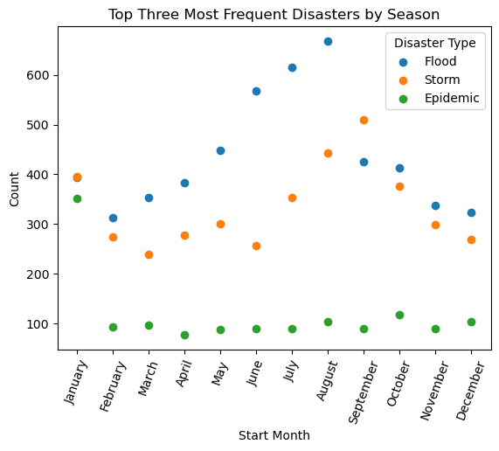
Seasonal Patterns:
Which months or seasons have higher frequencies of specific types of disasters?

Slide 11
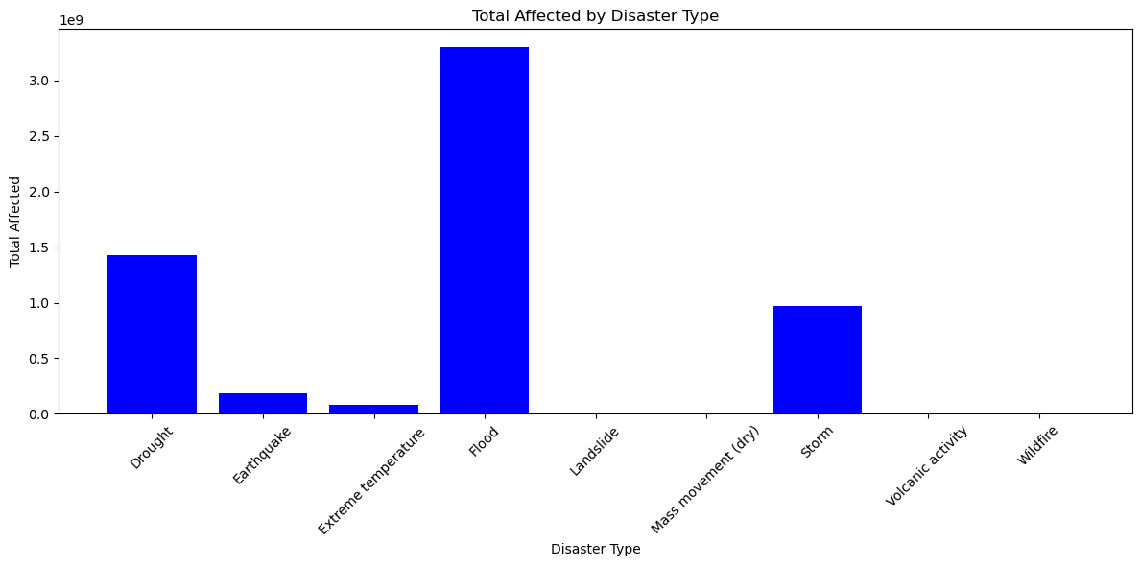
Human Impact:
- Are there particular disaster types that are more deadly or injurious than others?

Slide 12
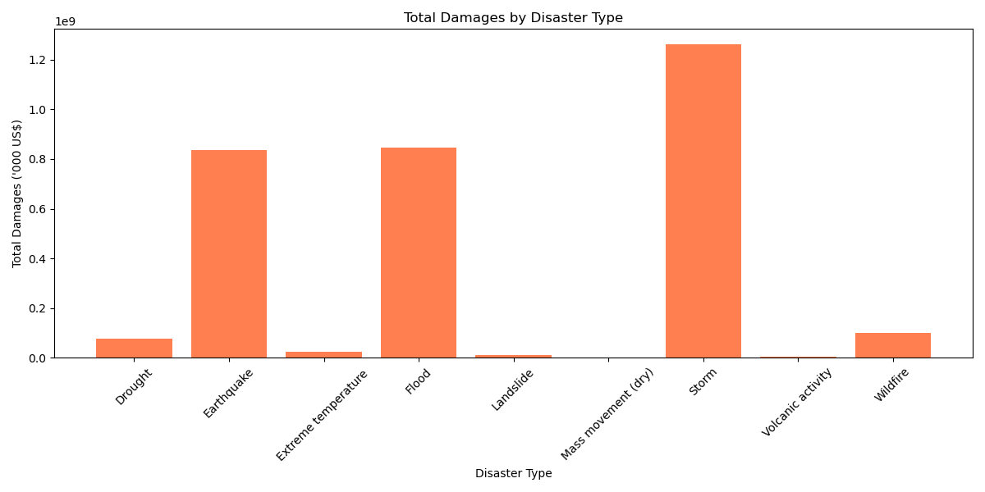
Economic Impact
How do total damages compare across different types of disasters?

Slide 13
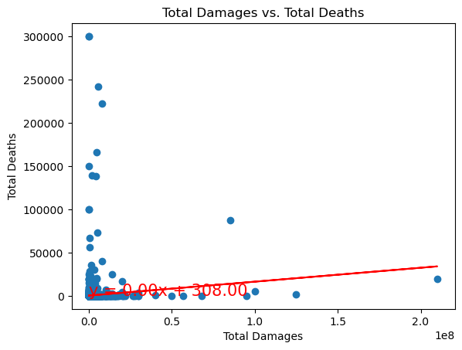
Correlation Between Total Deaths and Total Damages
Country | Total Deaths | Total Affected | Total Damages ('000 US$) | Latitude | Longitude
Afghanistan | 22939 | 34360790 | 578120 | 33.7680065 | 66.2385139
Albania | 264 | 4384418 | 783573 | 41.000028 | 19.9999619
Algeria | 7089 | 1961229 | 11783846 | 28.0000272 | 2.9999825
American Samoa | 40 | 25563 | 205000 | -14.297124 | -170.71315
Angola | 6222 | 7303362 | 12000 | -11.877577 | 17.5691241
There is no correlation between total deaths and total damages as shown in evaluation of human impact and economic impact.
Over these years, storms have been the most financially destructive disasters, while floods have caused the most loss of human life.
Notes:
Our goal is to examine the correlation between the cost of damages and the quantity of death brought on by disasters. There isn't much of a link between these two variables, according to the scatter plot's regression line. I believe it could be reasonable, If you remember two bar charts in previous slides, The gap is probably due to the fact that floods caused the majority of deaths while storms produced the most financial losses. This difference makes sense because storms normally do not result in a large number of deaths, but they frequently cause towns and homes to be destroyed, leaving people homeless.

Slide 14
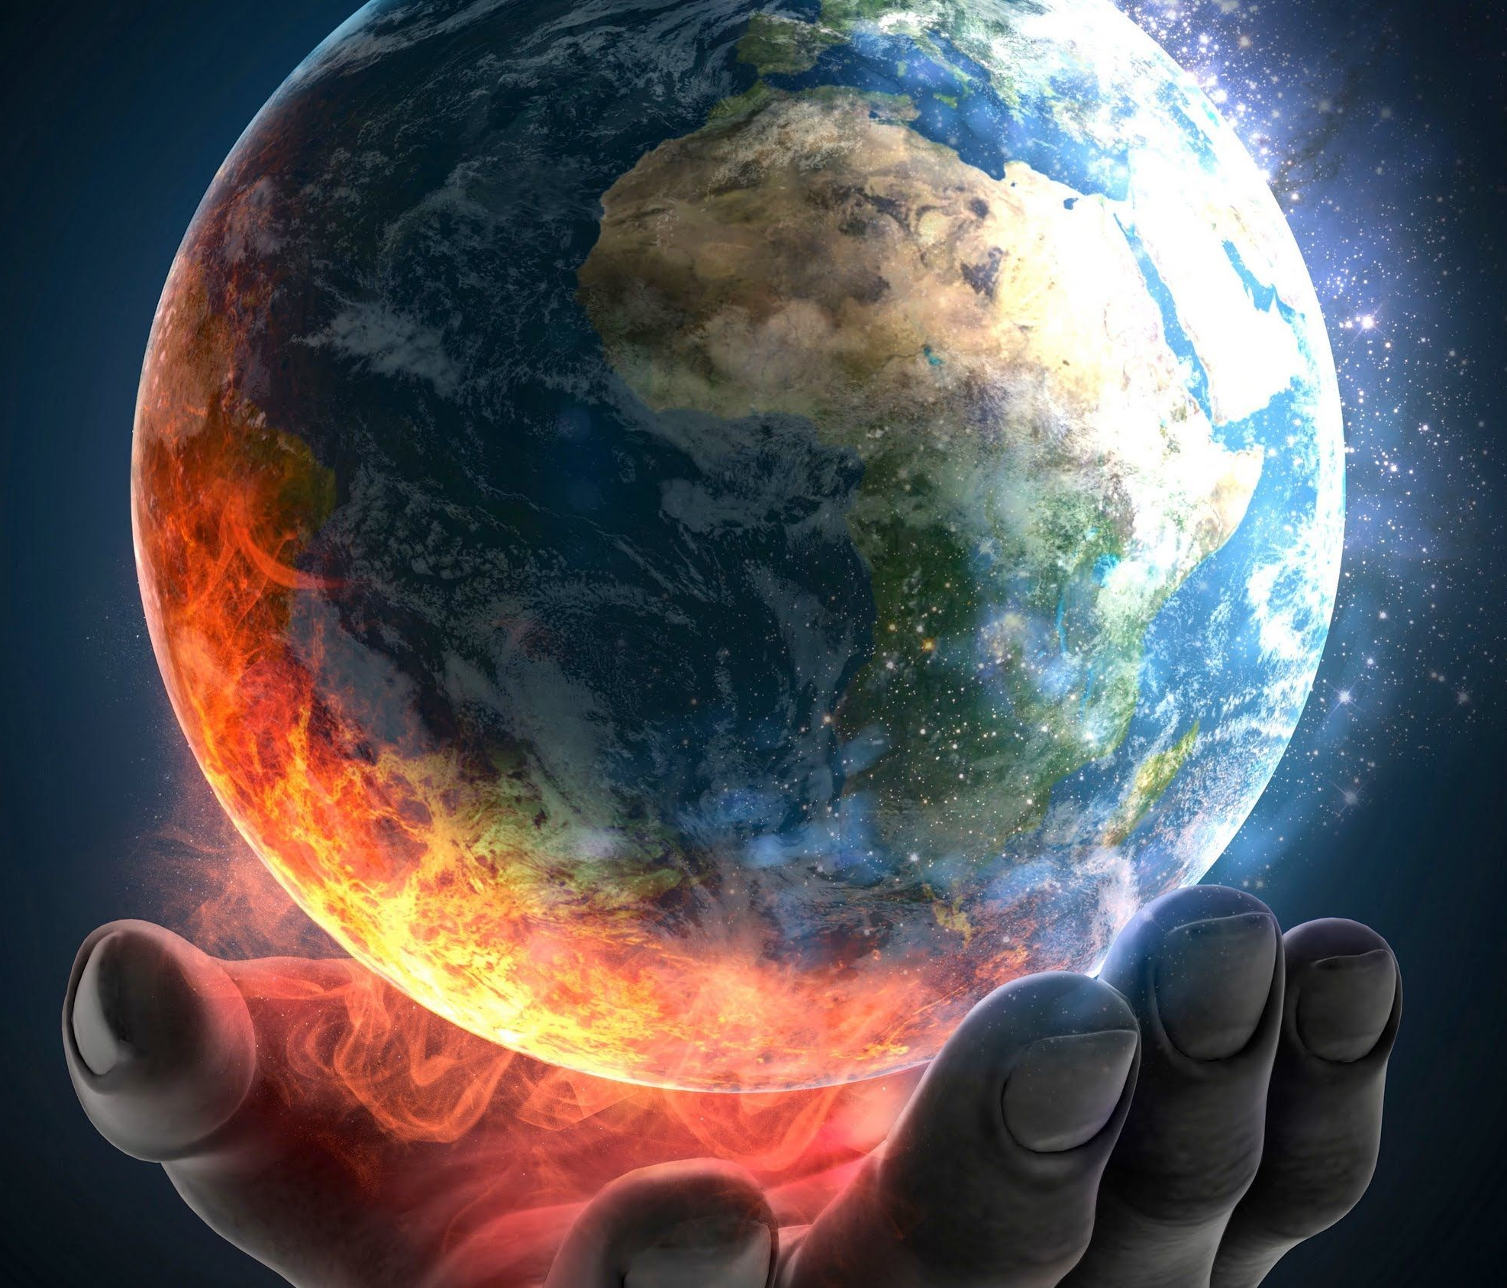
Conclusion
Increasing Frequency: There has been an observable increase in the frequency of disasters over the years.
Predominant Disaster Types: Storms and floods are the most frequent types of disasters.
Significant Impact: The economic damages from natural disasters are substantial, often running into billions of dollars, highlighting the need for robust economic safeguards and recovery plans.
Geographical Hotspots: Tailored disaster management plans are important because some areas are more prone to specific disasters than others.
Notes:
There has been an observable increase in the frequency of disasters over the years which could be attributed to climate change and increased reporting.
The most common types of disasters are floods and storms, indicating the necessity for specific strategies to prepare for these kind of events.
Natural disasters can cause enormous economic losses, frequently amounting to billions of dollars, emphasizing the importance of effective insurance policies and recovery strategies.
Plans for disaster management should be customized because certain regions are more at risk for different types of disasters than others.

Slide 15

Future…
The period after 2021 has been marked by unprecedented global challenges, including the COVID-19 pandemic, which compounded the impact of other disasters.
Notes:
Our disaster data spans from 1970 to 2021, but the COVID-19 pandemic has likely altered many factors, such as financial impacts, death tolls, and other affected areas. As a result, this data could significantly influence our results and evaluations.

Slide 16

Any Question?

